Slide 1
Unit 23
Functors and the Command Patterns
Design Patterns

Slide 2
Functors (函子)
Often when designing general-purpose software, we make use of callback functions (回调函数——通过函数指针调用的函数)
A callback function is a function that is made known (registered) to the system to be called at a later time when certain events occur
In C and C++ we can use pointers to functions as a callback mechanism, but this is not available in Java
In Java we must use an object that serves the role of a pointer to a function. (We could also use this technique in C++.)
A functor is a class with usually only one method whose instances serve the role of a pointer to a function. Functor objects can be created, passed as parameters and manipulated wherever function pointers are needed.
Coplien coined (创造) the word functor for this type of class
Notes:
Scope – class is static, inheritance
Object – references
回调函数(callback function)就是一个通过函数指针调用的函数。当把函数指针（地址）作为参数传递给另外一个函数，当这个指针被用来调用其所指向的函数时，我们就说这是回调函数。回调函数不是由该函数的实现方直接调用，而是在特定的事件或条件发生时由另外的一方调用的，用于对该事件或条件进行响应。

Slide 3
Functor Example 1
Consider a Utilities class with a class method that compares two Numbers. We would like to be able to specify the method of comparison at run-time, so we add a Comparator argument to the class method as follows:
  public class Utilities {
  public static int compareNumbers(Number a, Number b,
  Comparator c) {
  return c.compare(a, b);
  }
  }
Notes:
Less cluttered diagrams
Reminder

Slide 4
Functor Example 1 (Continued)
The Comparator object is a functor, since it acts like a pointer to the compare() function. To support different types of comparators, we'll use interface inheritance via a Java interface.
The Comparator interface is:
  public interface Comparator {
  public int compare(Number a, Number b);
  }
Many implementations of functors in Java involve the use of Java interfaces in this fashion
Notes:
OH with complete chart
Zimmer’s Gamma and Gamma’s Gamma not the same

Slide 5
Functor Example 1 (Continued)
Here is an Integer comparator:
// Integer comparator
public class IntComparator implements Comparator {
public int compare(Number a, Number b) {
int x = a.intValue();
int y = b.intValue();
if (x < y)
return -1;
else if (x > y)
return 1;
else
return 0;
}
}

Slide 6
Functor Example 1 (Continued)
And here is a String comparator:
  // String comparator
  public class StringComparator implements Comparator {
    public int compare(Number a, Number b) {
      String x = a.toString();
      String y = b.toString();
      if (x.compareTo(y) < 0)
        return -1;
      else if (x.compareTo(y) > 0)
        return 1;
      else
        return 0;
    }
  }

Slide 7
Functor Example 1 (Continued)
And here is a test program that demonstrates the use of the different comparators:
  public class TestUtilities {
    public static void main(String args[]) {
      // Create an integer Comparator.
      Comparator c1 = new IntComparator();
      // Compare two objects.
      int result = Utilities.compareNumbers(new Float(5.5),
      new Double(12.0), c1);
      System.out.println("Result is: " + result);
      // Create a string Comparator.
      Comparator c2 = new StringComparator();
Notes:
Combine last two slides

Slide 8
Functor Example 1 (Continued)
      // Compare the same two objects.
      result = Utilities.compareNumbers(new Float(5.5),
      new Double(12.0), c2);
      System.out.println("Result is: " + result);
    }
  }
Test program output:
  Result is: -1
  Result is: 1
Notes:
Uses, combine, similar
Strategy – flyweight: both stateless
OH with complete chart

Slide 9
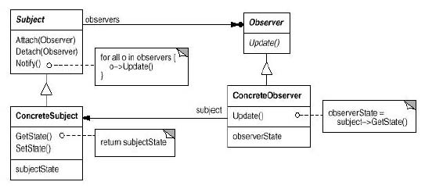
Functor Example 2
Consider a Java Observable object and its Observer objects. Each Observer implements the Observer interface and provides an implementation of the update() method. As far as the Observable is concerned, it essentially (本质上) has a pointer to an update() method to callback when Observers should be notified. So, in this case, each Observer object is acting as a functor.
Here's an Observer:
  public class NameObserver implements Observer {
    public void update(Observable obj, Object arg) {
      //Whatever
    }
    ...
  }
Notes:
Zimmer’s idéa

Slide 10
Functor Example 2 (Continued)
And here's an Observable. The notifyObservers() method makes the callback to update().
  public class ConcreteSubject extends Observable {
    public void setName(String name) {
      this.name = name;
      setChanged();
      notifyObservers(name);
    }
    ...
  }
Notes:
Very general
Used in a lot of other patterns
Applicability
Participants
Collaborations

Slide 11
Functor Example 3
Callbacks are used often in GUIs
For example, when an AWT button is pressed and released, it generates an action event which is sent to all registered listeners. Listeners must implement the ActionListener interface and implement the actionPerformed() method. The button invokes (calls back) the actionPerformed() method of the listener object.
This is really the Observer pattern!
Simple GUI example:
  public class MyApp extends Frame implements ActionListener {
    // GUI attributes.
    private Button goButton = new Button("Go");
    private Button exitButton = new Button("Exit");

Slide 12
Functor Example 3 (Continued)
  // MyApp Constructor
  public MyApp() {
    super("My Application");
    setupWindow();
}
  // Setup GUI.
  private void setupWindow() {
    Panel bottomPanel = new Panel();
    bottomPanel.add(goButton);
    bottomPanel.add(exitButton);
    // Register myself as an action listener for these buttons!
    goButton.addActionListener(this);
    exitButton.addActionListener(this);
    pack();
}

Slide 13
Functor Example 3 (Continued)
  // Handle GUI actions.
  // This is the callback function!
  public void actionPerformed(ActionEvent event) {
    Object src = event.getSource();
    if (src == goButton)
      go();
    else if (src == exitButton)
      System.exit(0);
  }
  // Main method.
  public static void main(String[] argv) {
    MyApp app = new MyApp();
    app.setVisible(true);
  }
}

Slide 14
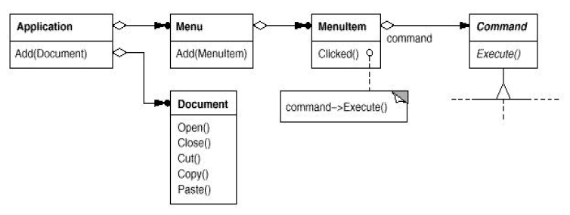
The Command Pattern
Intent
  Encapsulate requests for service from an object inside other objects, thereby letting you manipulate the requests in various ways
Motivation

Slide 15
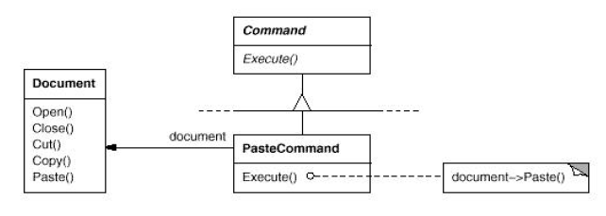
Functor Example 3 (Continued)
Motivation
Applicability
Use the Command pattern when
  You want to implement a callback function capability
  You want to specify, queue, and execute requests at different times
  You need to support undo and change log operations

Slide 16
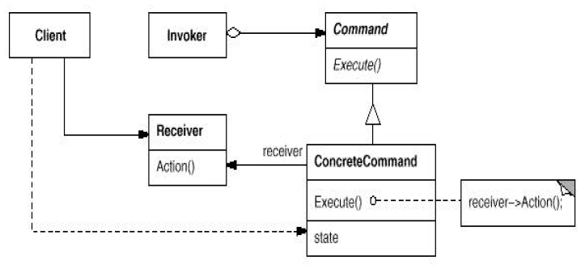
The Command Pattern
Structure

Slide 17
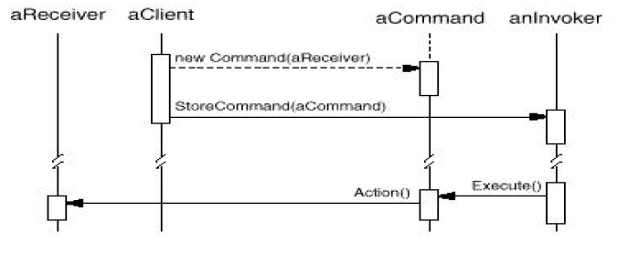
The Command Pattern
Collaborations

Slide 18
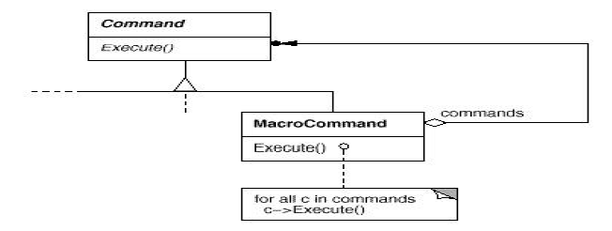
The Command Pattern
Consequences
  Command decouples the object that invokes the operation from the one that knows how to perform it
  Commands are first-class objects. They can be manipulated and extended like any other object.
  Commands can be made into a composite command

Slide 19
The Command Pattern
Implementation Issues
  How intelligent should a command object be?
    Dumb(Light): Delegates the required action to a receiver object
    Smart(Heavy): Implements everything itself without delegating to a receiver object at all
A functor object usually implements the desired behavior itself without delegation to another object. A command object frequently delegates the desired behavior to another receiver object.
If the command object simply implements the desired behavior itself, it is acting as a simple functor

Slide 20
Command Pattern Example 1
Situation: A GUI system has several buttons that perform various actions. We want to have menu items that perform the same action as its corresponding button.
Solution 1: Have one action listener for all buttons and menu items. As seen earlier, this is not a good solution as the resulting actionPerformed() method violates the Open-Closed Principle.
Solution 2: Have an action listener for each paired button and menu item. Keep the required actions in the actionPerformed() method of this one action listener. This solution is essentially the Command pattern with simple ConcreteCommand classes that perform the actions themselves, acting like functors
In Java 2, Swing Action objects are used for this purpose

Slide 21
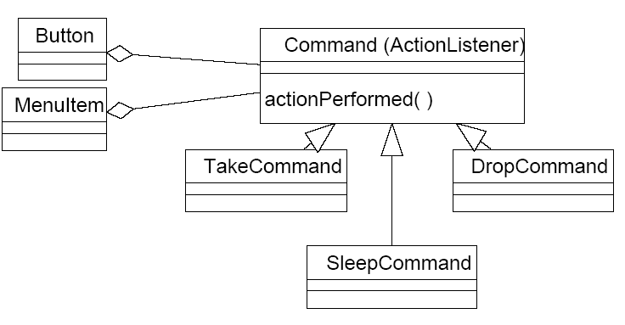
Command Pattern Example 1 (Continued)

Slide 22
Swing Actions
A Swing Action object is really just an ActionListener object that not only provides the ActionEvent handling, but also centralized handling of the text, icon, and enabled state of toolbar buttons or menu items
The same Action object can easily be associated with a toolbar button and a menu item
The Action object also maintains the enabled state of the function associated with the toolbar button or menu item and allows listeners to be notified when this functionality is enabled or disabled

Slide 23
Swing Actions
In addition to the actionPerformed method defined by the ActionListener interface, objects that implement the Action interface provide methods that allow the specification of:
  One or more text strings that describe the function of the button or menu item
  One or more icons that depict the function
  The enabled/disabled state of the functionality
By adding an Action to a JToolBar or JMenu, you get:
  A new JButton (for JToolBar) or JMenuItem (for JMenu ) that is automatically added to the tool bar or menu. The button or menu item automatically uses the icon and text specified by the Action.
  A registered action listener (the Action object) for the button or menu item
  Centralized handling of the button's or menu item's enabled state

Slide 24
Swing Actions Example
  /**
  * Class SwingActions demonstrates the Command Pattern
  * using Swing Actions.
  */
  public class SwingActions extends JFrame {
    private JToolBar tb;
    private JTextArea ta;
    private JMenu fileMenu;
    private Action openAction;
    private Action closeAction;
    public SwingActions() {
      super("SwingActions");
      setupGUI();
    }

Slide 25
Swing Actions Example (Continued)
    private void setupGUI() {
      //Create the toolbar and menu.
      tb = new JToolBar();
      fileMenu = new JMenu("File");
      //Create the text area used for output.
      ta = new JTextArea(5, 30);
      JScrollPane scrollPane = new JScrollPane(ta);
      //Layout the content pane.
      JPanel contentPane = new JPanel();
      contentPane.setLayout(new BorderLayout());
      contentPane.setPreferredSize(new Dimension(400, 150));
      contentPane.add(tb, BorderLayout.NORTH);
      contentPane.add(scrollPane, BorderLayout.CENTER);
      setContentPane(contentPane);

Slide 26
Swing Actions Example (Continued)
    //Set up the menu bar.
    JMenuBar mb = new JMenuBar();
    mb.add(fileMenu);
    setJMenuBar(mb);
    // Create an action for "Open".
    ImageIcon openIcon = new ImageIcon("open.gif");
    openAction = new AbstractAction("Open", openIcon) {
      public void actionPerformed(ActionEvent e) {
        ta.append("Open action from " + e.getActionCommand() +"\n");
      }
    };
    // Use the action to add a button to the toolbar.
    JButton openButton = tb.add(openAction);
    openButton.setText("");
    openButton.setActionCommand("Open Button");
    openButton.setToolTipText("This is the open button");

Slide 27
Swing Actions Example (Continued)
    // Use the action to add a menu item to the file menu.
    JMenuItem openMenuItem = fileMenu.add(openAction);
    openMenuItem.setIcon(null);
    openMenuItem.setActionCommand("Open Menu Item");
    // Create an action for "Close" and use the action to add
    // a button to the toolbar and a menu item to the menu.
    // Code NOT shown - similar to "open" code above.
  }
  public static void main(String[] args) {
    SwingActions frame = new SwingActions();
    frame.pack();
    frame.setVisible(true);
  }
}

Slide 28
Command Pattern Example 2
Scenario: We want to write a class that can periodically execute one or more methods of various objects. For example, we want to run a backup operation every hour and a disk status operation every ten minutes. But we do not want the class to know the details of these operations or the objects that provide them. We want to decouple the class that schedules the execution of these methods with the classes that actually provide the behavior we want to execute.

Slide 29
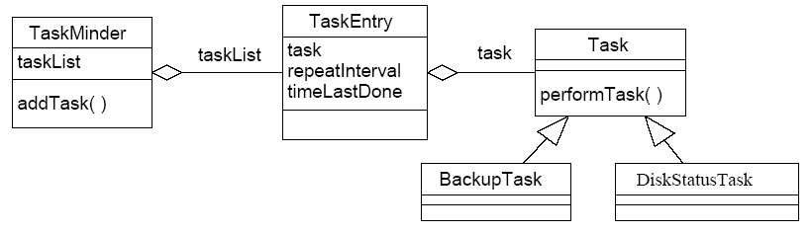
Command Pattern Example 2 (Continued)
Solution: The Command Pattern!
Here’s the Task interface:
  public interface Task {
    public void performTask();
  }

Slide 30
Command Pattern Example 2 (Continued)
Instead of a BackupTask or DiskStatusClass, here is a simple Fortune Teller Task which cycles through a list of fortune sayings:
  public class FortuneTask implements Task {
    int nextFortune = 0;
    String[] fortunes = {"She who studies hard, gets A",
      "Seeth the pattern and knoweth the truth",
      "He who leaves state the day after final, graduates not" };
    public FortuneTask() {}
    public void performTask() {
      System.out.println("Your fortune is: " +
      fortunes[nextFortune]);
      nextFortune = (nextFortune + 1) % fortunes.length;
    }
    public String toString() {return ("Fortune Telling Task");}
  }

Slide 31
Command Pattern Example 2 (Continued)
And here is a Fibonacci Sequence Task which generates a sequence of Fibonacci numbers:
  public class FibonacciTask implements Task {
    int n1 = 1;
    int n2 = 0;
    int num;
    public FibonacciTask() {}
    public void performTask() {
    num = n1 + n2;
    System.out.println("Next Fibonacci number is: " + num);
    n1 = n2;
    n2 = num;
  }
    public String toString() {return ("Fibonacci Sequence Task");}
  }

Slide 32
Command Pattern Example 2 (Continued)
Here is the TaskEntry class:
  public class TaskEntry {
    private Task task // The task to be done
    // It's a Command object!
    private long repeatInterval; // How often task should be
    // executed
    private long timeLastDone; // Time task was last done
    public TaskEntry(Task task, long repeatInterval) {
    this.task = task;
    this.repeatInterval = repeatInterval;
    this.timeLastDone = System.currentTimeMillis();
  }
  public Task getTask() {return task;}

Slide 33
Command Pattern Example 2 (Continued)
  public void setTask(Task task) {this.task = task;}
  public long getRepeatInterval() {return repeatInterval;}
  public void setRepeatInterval(long ri) {
    this.repeatInterval = ri;
  }
  public long getTimeLastDone() {return timeLastDone;}
  public void setTimeLastDone(long t) {this.timeLastDone = t;}
  public String toString() {
    return (task + " to be done every " + repeatInterval +
    " ms; last done " + timeLastDone);
  }
}

Slide 34
Command Pattern Example 2 (Continued)
Here is the TaskMinder class:
  public class TaskMinder extends Thread {
    private long sleepInterval; // How often the TaskMinder should
    // check for tasks to be run
    private Vector taskList; // The list of tasks
    public TaskMinder(long sleepInterval, int maxTasks) {
      this.sleepInterval = sleepInterval;
      taskList = new Vector(maxTasks);
      start();
    }
  public void addTask(Task task, long repeatInterval) {
    long ri = (repeatInterval > 0) ? repeatInterval : 0;
    TaskEntry te = new TaskEntry(task, ri);
    taskList.addElement(te);
  }

Slide 35
Command Pattern Example 2 (Continued)
  public Enumeration getTasks() {return taskList.elements();}
  public long getSleepInterval() {return sleepInterval;}
  public void setSleepInterval(long si) {
    this.sleepInterval = si;
  }
  public void run() {
    while (true) {
    try {
      sleep(sleepInterval);
      long now = System.currentTimeMillis();
      Enumeration e = taskList.elements();

Slide 36
Command Pattern Example 2 (Continued)
    while (e.hasMoreElements()) {
      TaskEntry te = (TaskEntry) e.nextElement();
      if (te.getRepeatInterval() + te.getTimeLastDone() <now) {
        te.getTask().performTask();
        te.setTimeLastDone(now);
      }
    }
  }
  catch (Exception e) {
    System.out.println("Interrupted sleep: " + e);
  }}}}

Slide 37
Command Pattern Example 2 (Continued)
Test program:
  public class TestTaskMinder {
    public static void main(String args[]) {
      // Create and start a TaskMinder.
      // This TaskMinder checks for things to do every 500 ms
      // and allows a maximum of 100 tasks.
      TaskMinder tm = new TaskMinder(500, 100);
      // Create a Fortune Teller Task.
      FortuneTask fortuneTask = new FortuneTask();
      // Have the Fortune Teller execute every 3 seconds.
      tm.addTask(fortuneTask, 3000);

Slide 38
Command Pattern Example 2 (Continued)
    // Create a Fibonacci Sequence Task.
    FibonacciTask fibonacciTask = new FibonacciTask();
    // Have the Fibonacci Sequence execute every 700
    // milliseconds.
    tm.addTask(fibonacciTask, 700);
  }
}

Slide 39
Command Pattern Example 2 (Continued)
Test program output:
  Next Fibonacci number is: 1
  Next Fibonacci number is: 1
  Your fortune is: She who studies hard, gets A
  Next Fibonacci number is: 2
  Next Fibonacci number is: 3
  Next Fibonacci number is: 5
  Next Fibonacci number is: 8
  Your fortune is: Seeth the pattern and knoweth the truth
  Next Fibonacci number is: 13
  Next Fibonacci number is: 21
  Next Fibonacci number is: 34
  Your fortune is: He who leaves state the day after final,
  graduates not
  Next Fibonacci number is: 55
  Next Fibonacci number is: 89
  Next Fibonacci number is: 144
  etc.

Slide 40
Conclusion
Functors
Command

